Slide 1


SPOTIFY PLAYLIST MAKER:
GENRE CLUSTERING
Christian Sarmiento - DATA 450

Slide 2

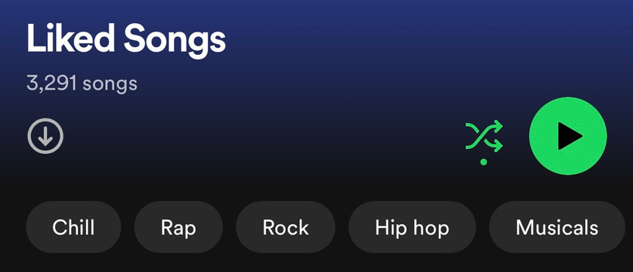

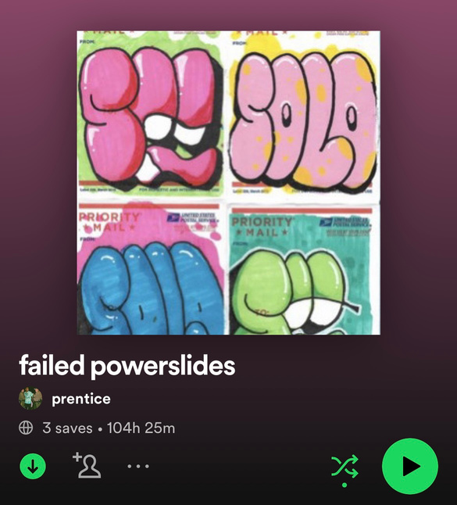
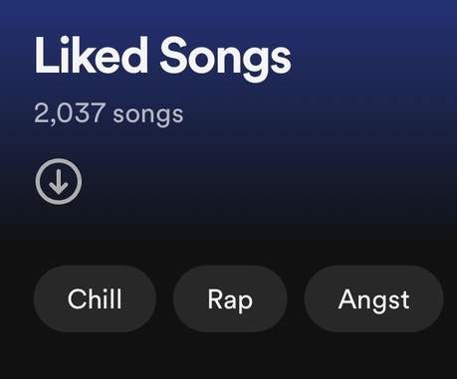
OUR PROBLEM:
MAKING PLAYLISTS IS HARD & TIME CONSUMING
Although listening to and accumulating a lot of music is fun, listening to long playlists becomes harder the longer they are due to Spotify’s shuffling algorithm that isn’t truly random, resulting in users not being able to listen to all of the music they’ve accumulated.
This can make playlist making, an already long and tedious process, an even longer and arduous process, having to go through each song and decide if it fits the theme of the playlist you are trying to make.
Since playlist-making takes such a long time, this sometimes deters users from making playlists to begin with, resulting in shuffling through liked songs.

Slide 3

Our Solution
Spotify Data
WE ARE HERE
Model 1:
Model 2:
Model 3:
Genre Clustering
Take genre clusters and make playlists/ mixes of genres for playlists*
Classify the genre of the new playlist and develop a name for it*
New Playlist(s)
Frontend Application:
Allows users to view all possible playlists given a link and allows for selection on which ones are made*
*- Future project, details TBD

Slide 4


MODEL 1: GENRE CLUSTERING
GOAL
DATA
Evaluate the accuracy of four different clustering algorithms to determine which is the best to cluster genres for making playlists.
Data was sourced through Kaggle which was sourced through the Spotify API to aggregate 114,000 song records.

Slide 5
NOTABLE ATTRIBUTES
OVERVIEW
The dataset contains 21 different attributes. Here are the notable ones:
Popularity - measure from 0-100 of how popular the track is.
Danceability - value from 0 - 1 measuring how suitable the track is for dancing.
Energy - measure from 0 - 1 of how energetic the track is.
Speechiness - uses a measure from 0 - 1 to determine the presence of spoken words in a track. The closer to 1, the more of a chance it is purely just speaking (audiobooks, track skits, etc.).
Acousticness - measures how acoustic a track is, measured from 0 - 1.
Instrumentalness - Presence of no vocals and just instruments, measure from 0 - 1: 1 indicating all instruments.
Liveness - measure from 0 - 1 detecting the presence of a live crowd in the track.
Valence - measure from 0 - 1 tracking the “musical positiveness” in a track. The closer to 1, the more happy the track sounds.
Other Attributes Included & Used:
Musical Measures (key, mode, tempo, time_signature)
track_genre
duration (milliseconds)
explicit (yes or no)

Slide 6
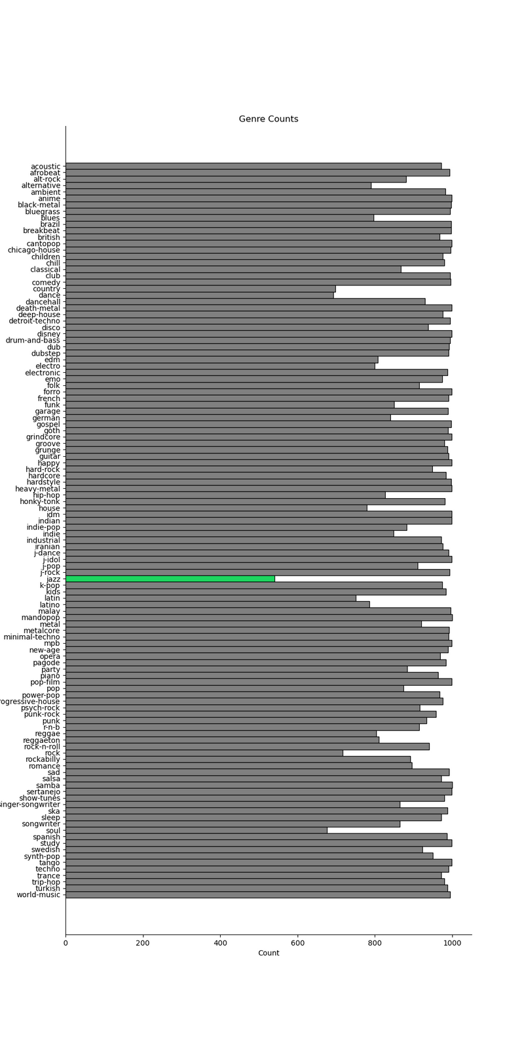
DATA EXPLORATION
INITIAL OBSERVATIONS
First thing that was looked at was the distribution for Genre. It is absolutely CRUCIAL that no one genre is over/under represented in the sample.
114 Unique Genres
Without cleaning, each genre has exactly 1,000 records.
450 exact record duplicates.
6601 inexact duplicates - album name and track ID don’t match, everything else does (perhaps an artist released a single before the album, or re-released an album years later/released a “hits-only” album.
After cleaning, genre count minimum reaches 540 records (Jazz), with a standard deviation of 87.27 (median = 979).
Although data loss is unfortunate, this can be considered pretty minimal compared to the amount of records we have left.
N = 106,949

Slide 7
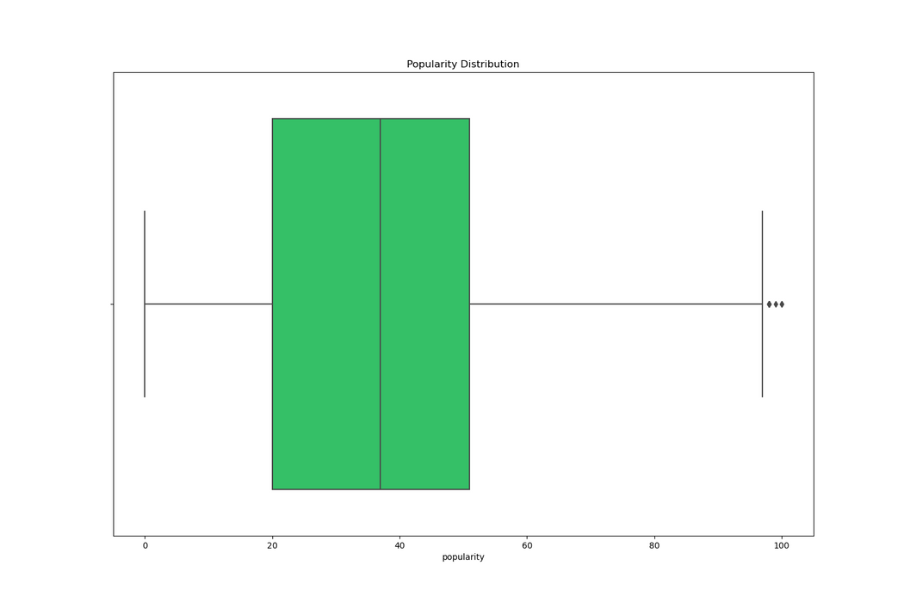
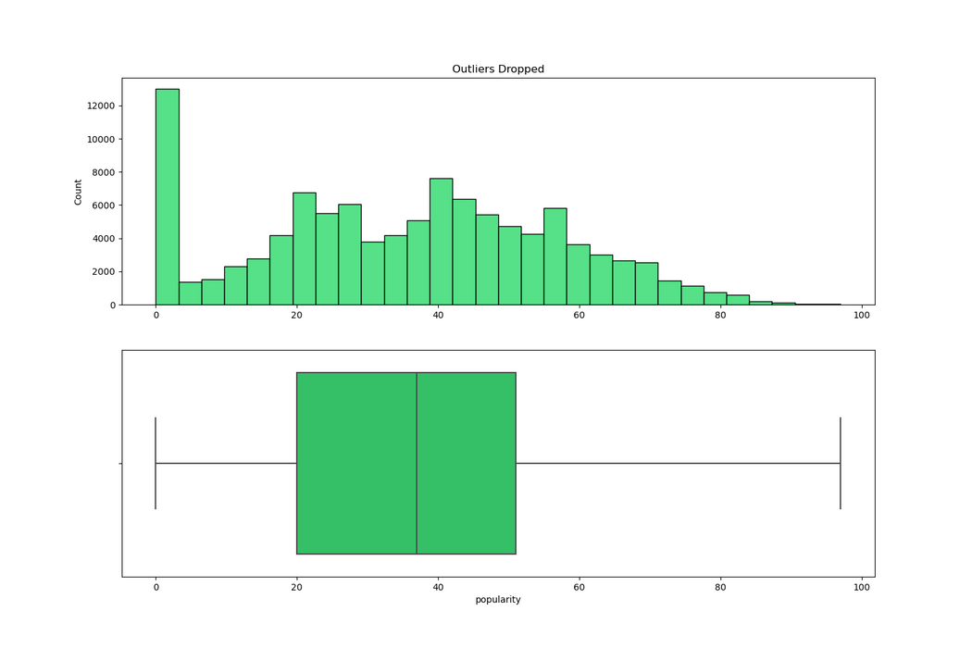
NOTABLE DISTRIBUTIONS & DROPPING OUTLIERS
POPULARITY
After taking a look at genre, we take a look at the different distributions in our dataset. All outliers were dropped using IQR, tweaking the range of dropping as needed. If outliers still were present, remaining outliers were dropped using a brute-force approach. Here are a few notable distributions
Popularity would be relatively normal if there weren’t a lot of entries for unpopular songs.
This makes sense since it is a lot harder to have a popular song than not.
Because of this, it might be worth looking into dropping this variable later on since we might risk skewing our data in where one genre may be more popular than others, which we look to avoid.

Slide 8
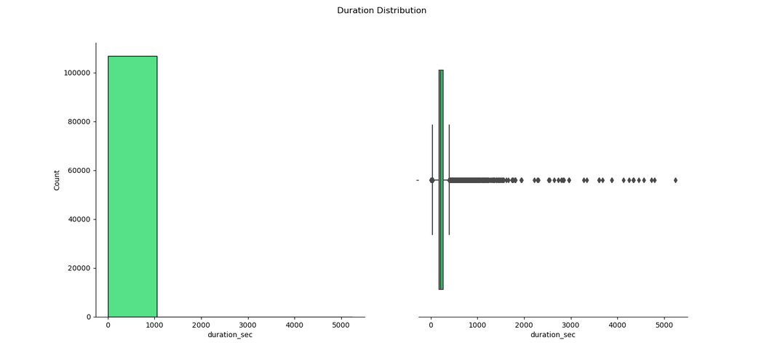
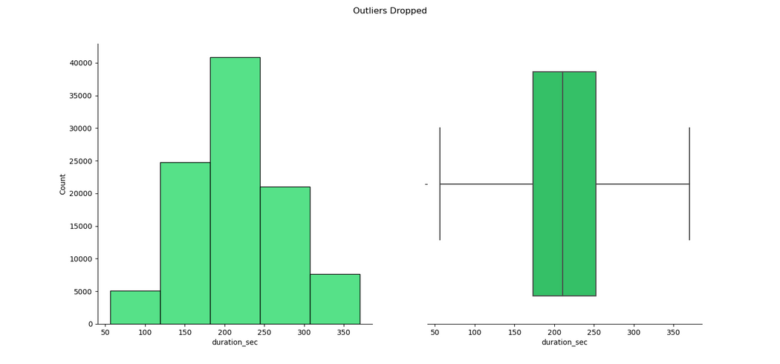
NOTABLE DISTRIBUTIONS & DROPPING OUTLIERS
DURATION
For duration, we first converted the scale from milliseconds to seconds.
We removed outliers with IQR and then again with brute force.
After removing our outliers, we can see that our attribute is normally distributed.

Slide 9
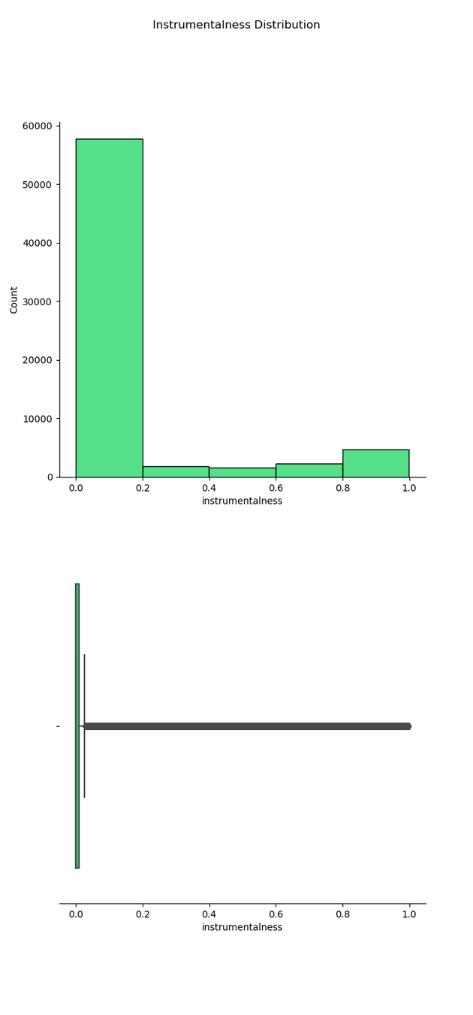
NOTABLE DISTRIBUTIONS & DROPPING OUTLIERS
INSTRUMENTALNESS
Instrumentalness is measuring how instrumental a track is.
Therefore, we are going to decide to refrain from dropping these outliers for right now since these data points may be telling of genre.
The idea of dropping these outliers can be revisited later if outliers prove to have unwanted effects.

Slide 10
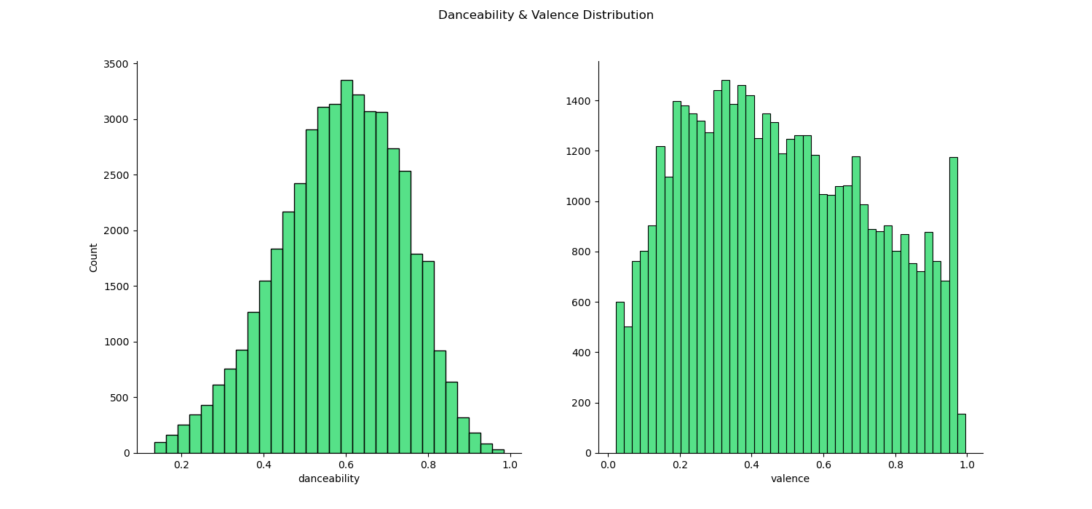
NOTABLE DISTRIBUTIONS & DROPPING OUTLIERS
NORMAL & SKEWED DISTRIBUTIONS
Skewed Distributions
Energy (Left-Skew)
Loudness (Left-Skew)
Speechiness (Right-Skew)
Acousticness (Right-Skew)
Liveness (Right-Skew)
Normal Distributions
Danceability (Cutting it close)
Valence (Cutting it close)
Tempo
Note: After dropping outliers, n =45,671

Slide 11
NOTABLE DISTRIBUTIONS & DROPPING OUTLIERS
CATEGORICAL DISTRIBUTIONS
Mode
Key
Major - 65%
Minor - 35%
Max: C - About 12%
Min: D#/Eb - About 3%
Time Signature (Beats Per Bar)
Explicit
7/4 - 91%
6/8 - 7%
5/4 - 1%
4/4 & 3/4 - 1%
Not Explicit - 95%
Explicit - 5%
This variable may be dropped due to explicitness not really being telling of genre (most artists drop explicit/non-explicit versions of music either way)

Slide 12
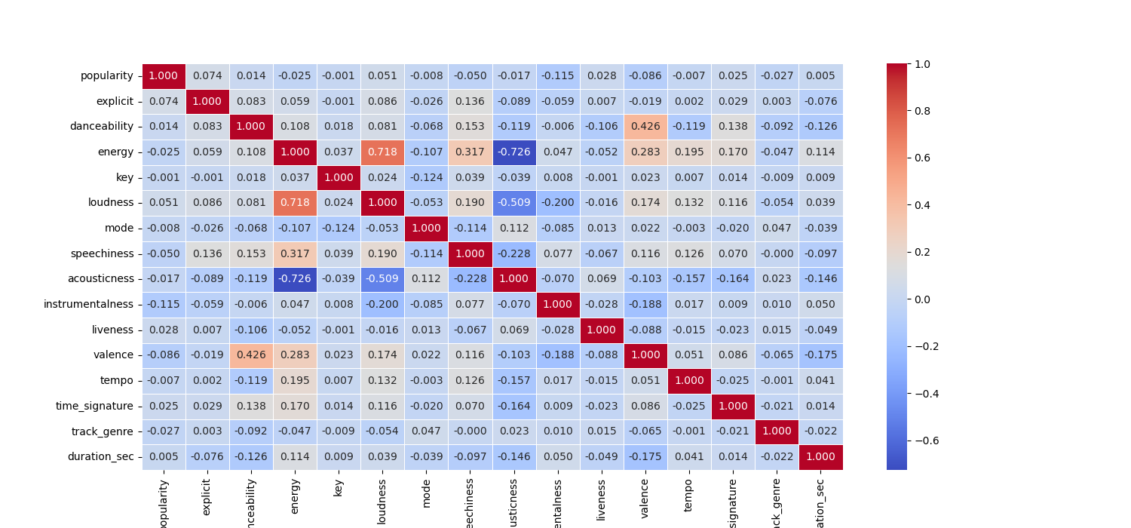
DATA EXPLORATION
CORRELATION MATRIX

Slide 13
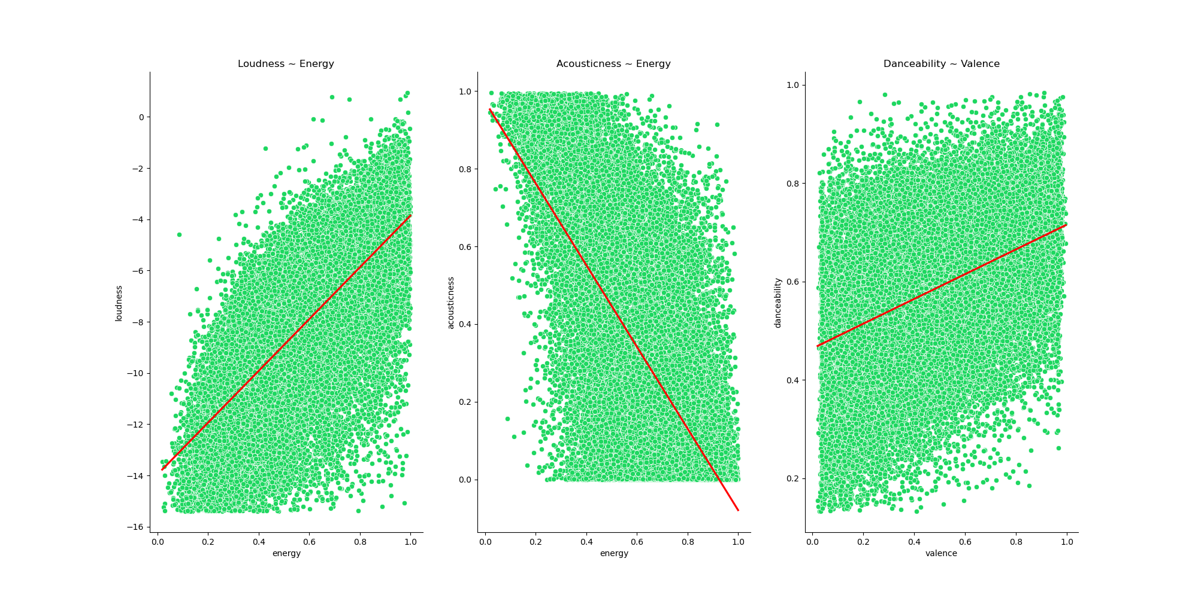
DATA EXPLORATION
SCATTERPLOTS

Slide 14
DATA PREPROCESSING
CHOOSING CLUSTERING ALGORITHMS
4 Clustering Algorithms:
K-Means Clustering
Distance-based algorithm
Scalable to large samples of n
Separates n samples into k clusters
Hard Clustering (one sample -> one cluster)
Bisecting K-Means Clustering
Variation of K-Means where n is automatically partitioned instead of being directly separated.
Partitions determine the next cluster (hierarchical clustering)
Good for large cluster sizes (we may want to look into this)
Hard Clustering
Fuzzy K-Means Clustering
Distance-based algorithm
Soft Clustering (one sample -> >1 cluster)
Affinity Propagation Clustering
Similarity-based algorithm
Cluster size is automatically determined based on the size of n
Time-complexity is 0(N^2 T), making it slower as n is bigger
Soft clustering, based on sending messages between points until convergence is met.

Slide 15
DATA PREPROCESSING
PREPARING OUR DATASETS
4 Datasets
Original Dataset
Original attributes.
No attributes are standardized or normalized.
Used to serve as a benchmark for the other preprocessing techniques.
Standardized/Normalized Dataset
Original attributes, popularity & explicit are dropped.
Attributes that need to be standardized are standardized (popularity, loudness, tempo, duration).
Skewed attributes are normalized (energy, loudness, speechiness, liveness).
1 PCA
PCA performed on standardized/normalized dataset.
n_components = 7 or optimal (if 7 is not good).
3 PCAs
Three new variables are made with PCA using the standardized/normalized dataset:
energetic_loud
energy, loudness, speechiness
upbeat_happy
danceability, valence, instrumentalness
musical_measures
key, mode, tempo, time_signature

Slide 16
Questions?

